Slide 1

Market Price Prediction
By : Suzy Adel

Slide 2
Intro

Slide 3
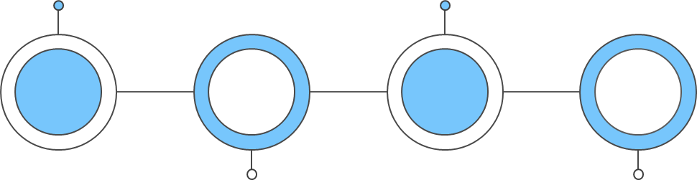
Task 3: Market Price Prediction
Problem Statement
Task
1
2
3
4
Objective
Outcome

Slide 4
Task 3: Market Price Prediction
Problem Statement
Problem: Existing market analysis and forecasting methods are insufficiently accurate, resulting in inefficiencies in production, procurement, and resource allocation for various commodities.
Challenge: To enhance decision-making, stakeholders need a sophisticated, data-driven approach to accurately predict market behaviors and trends.
Task
1
2
3
4
Objective
Outcome

Slide 5
Task 3: Market Price Prediction
Objective
Develop a robust time series machine learning model that can accurately forecast future market trends for various commodities based on historical data.
Provide stakeholders with actionable insights to improve production planning, pricing strategies, and resource management, thereby optimizing overall market efficiency and profitability.
Problem Statement
Task
1
2
3
4
Outcome

Slide 6
Task 3: Market Price Prediction
Task
Clean and preprocess the data, analyze and engineer features, evaluate and select suitable time series forecasting models, train and fine-tune the models, and deploy a production-ready model to provide accurate market forecasts.
Problem Statement
1
2
3
4
Objective
Outcome

Slide 7
Task 3: Market Price Prediction
Outcome
Achieve a significant reduction in forecasting errors, leading to more precise inventory management and reduced wastage of resources.
Enable more effective budgeting and financial forecasting for businesses by providing reliable data on future market conditions.
Problem Statement
Task
1
2
3
4
Objective

Slide 8

Code Theory

Slide 9


Steps In Market Price Prediction
1
2
3
4
Data Preparation
Divide into train and test data
Create a time step
Data cleaning
preparing the dataset for modeling by handling missing values
correcting errors,
ensuring consistency.
Modeling & Training
selecting and training machine learning algorithms on the prepared dataset to develop a predictive model.
Performance analysis
assessing the predictive model's effectiveness and making necessary adjustments to improve its accuracy and reliability.

Slide 10
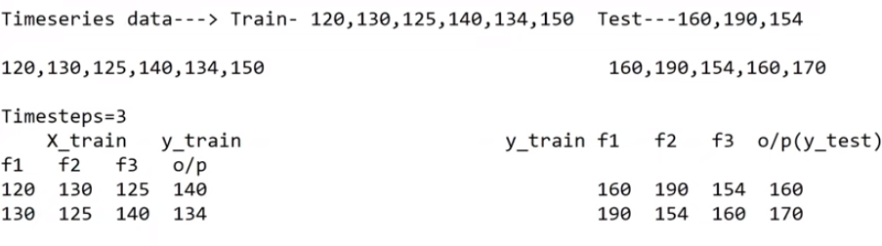
Theoretical Example
First you have to make sure you have enough data to train your model so it doesn’t learn noise as part of the pattern not too many , overfitting or Underfitting where the model has a poor relationship and cant predict properly due to few data

Slide 11
Theoretical Example
You also have to make sure there is enough data to test the model enough to ensure it is correctly predicting

Slide 12
Theoretical Example
During training you take a train of data you already know (x_train) and assign the one after in the sequence as (y_train) and you repeat to teach the model

Slide 13
Theoretical Example
During training this data set is know KNOWN/ LEARNED by the model and is ready to test what the model learned on
UNSEEN DATA

Slide 14
Theoretical Example
During Testing the model predicts the following one in the sequence until it reaches the end of the UNSEEN data

Slide 15
Theoretical Example
This is Time Step or "look-back period" or "window size.“
When you increase the time step, you are effectively increasing the amount of historical information the model uses to make predictions.

Slide 16
Effects of a Bigger Time Step
01
02
Benefits
Withdraws
By including more past data points, it captures longer-term dependencies which is useful for complex time series with long-term patterns.
A larger time step can improve the model's ability to generalize to new data by leveraging more historical information.
If the model becomes too complex, it can lead to overfitting, where the model performs well on the training data but poorly on unseen data.
If the additional historical data does not provide useful information for future predictions, it can confuse the model and degrade its performance.

Slide 17
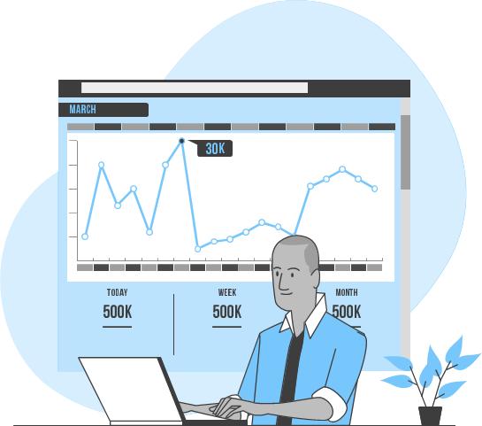
Code Results
Stacked LSTM Regression model

Slide 18
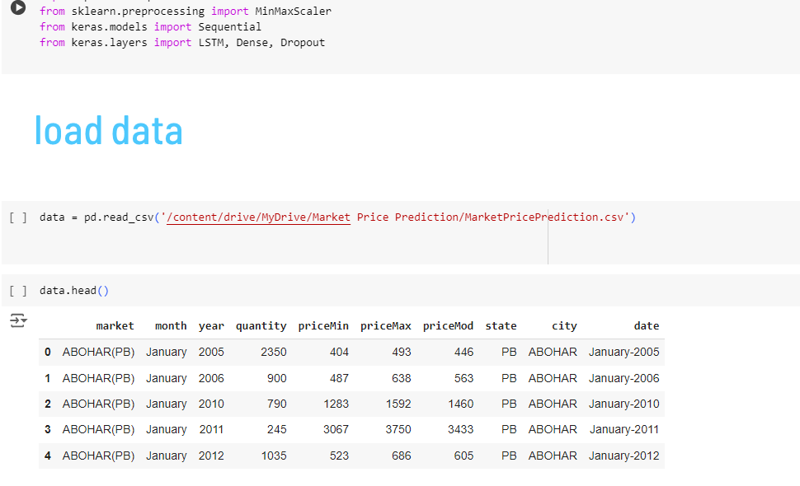
First I Imported the dataset and inspect the structure and data types.

Slide 19
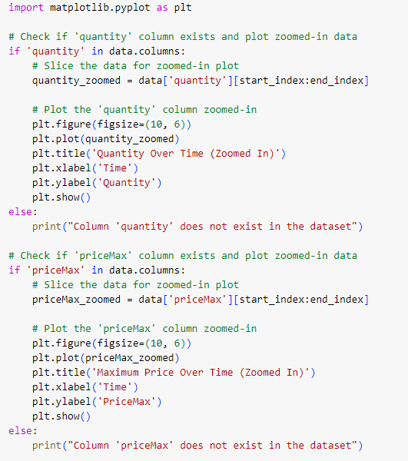
Secondly I Visualized the trends and seasonality in quantities and prices, at the first without zooming it was unclear to understand ,
thus I had to look at a certain part and study section by section,
this issue can be solved by using less data and cleaning the data more however,
I was trying to train it on everything to reduce its chances to overfit

Slide 20
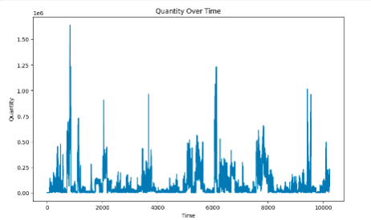
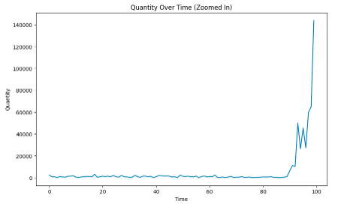
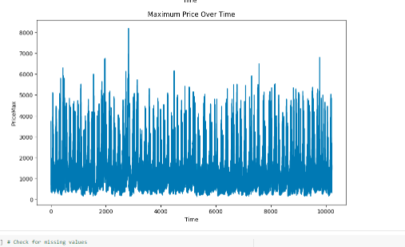
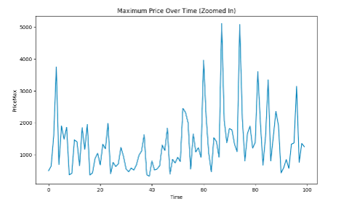
Here is the difference , and now you can tell I took the first section to study its quantity and its maximum price

Slide 21
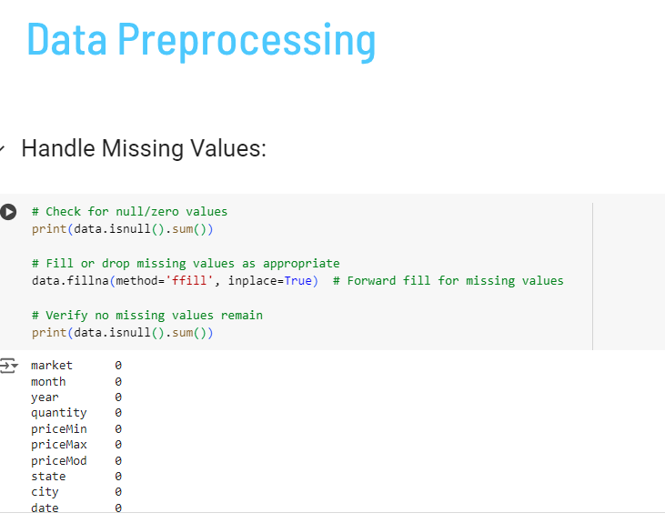
Here I tried to Identify and handle any missing values in the dataset. Common techniques include imputation with mean/median/mode or using advanced methods like KNN imputation.
I didn’t have to that since the sum of the missing values in all rows were zero

Slide 22
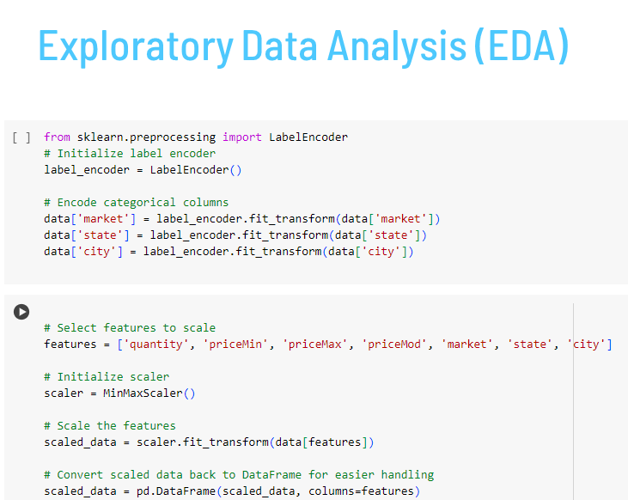
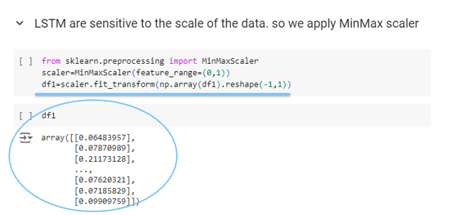
Convert categorical variables (e.g., market, state, city) into numerical format using techniques like one-hot encoding or label encoding.

Slide 23
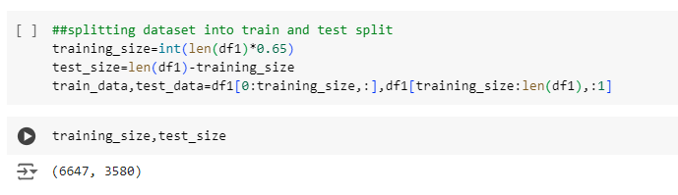
The data is then split to training data which the model will learn and creates its dependency links , then the rest will be the test data which will act as the unseen data
The indexing will go from
0->training_size
training_size -> length/end of the data
65% Training Data
35% Testing Data

Slide 24
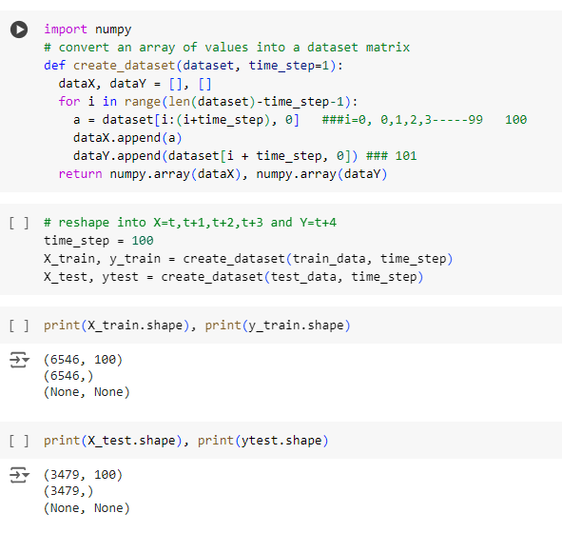
The data is then split 100 values as a window and the 101th is the predicted value where the 100 values act like the historical data to built dependencies, where x value train is an array repeated on the number of rows (6546*100)
And the predicted value is
1 value per row (6546*1)
This is also repeated for both the training 6546 rows
(65% of the original data size)
and the 3479 rows of testing data
(35% of original data )

Slide 25
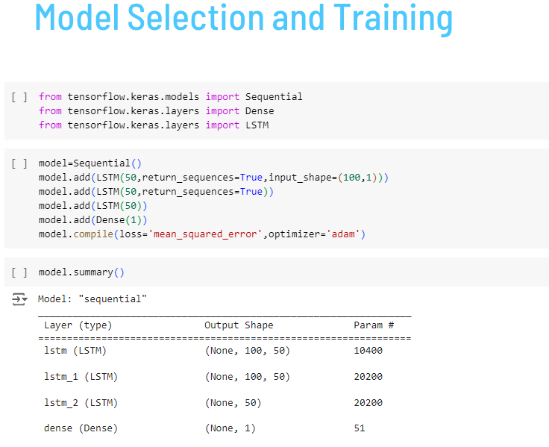
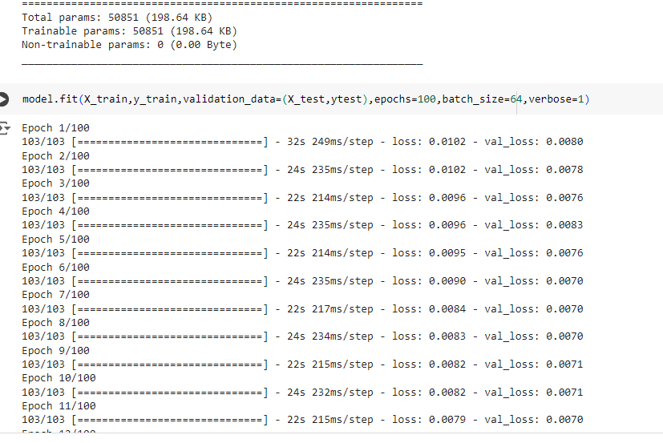
Selected and trained machine learning algorithm
(STACKED LSTM)
on the prepared dataset to develop a predictive model

Slide 26
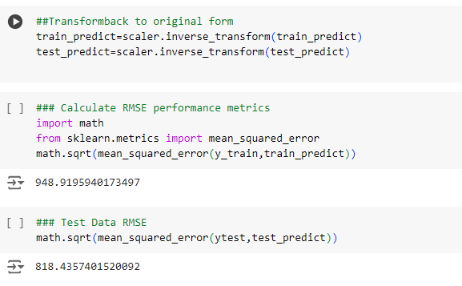
These value represents the average difference between the predicted and actual values in the training/test dataset.

Slide 27
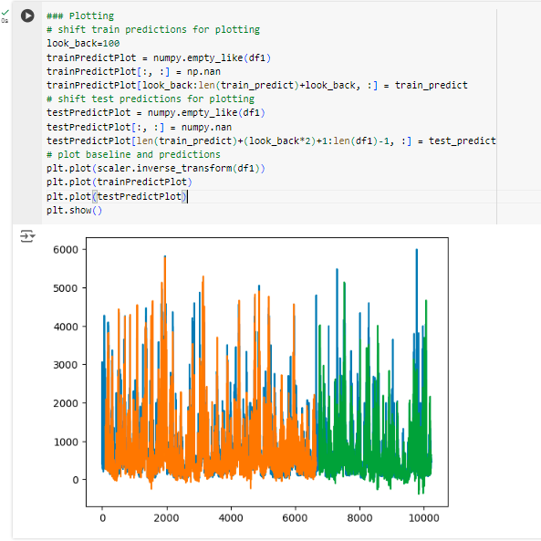
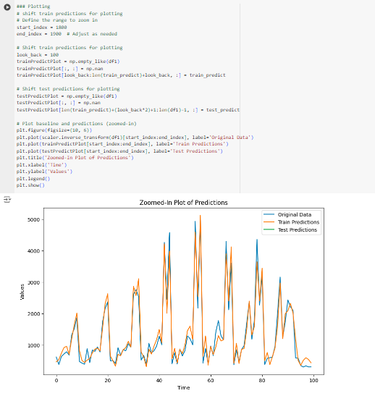
This shows that the data may be overtrained and caused the model to be off the actual value , therefore the next time I should try minimizing the train

Slide 28
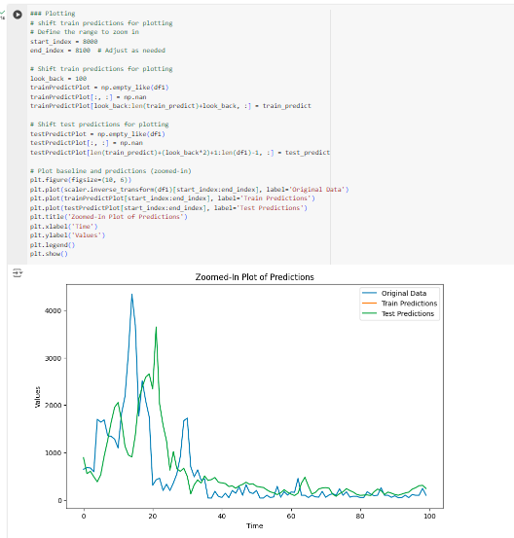
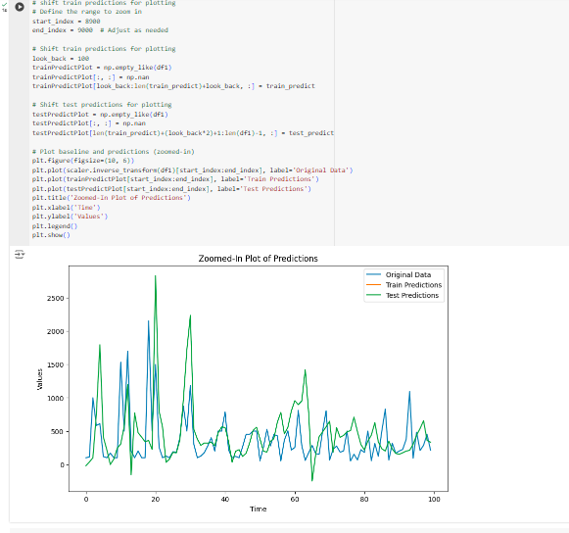
This shows that the test data is quite off , due to the previously mentioned reasons, and not because there are many data rows I should build big dependencies especially that the relationship is not too complex

Slide 29
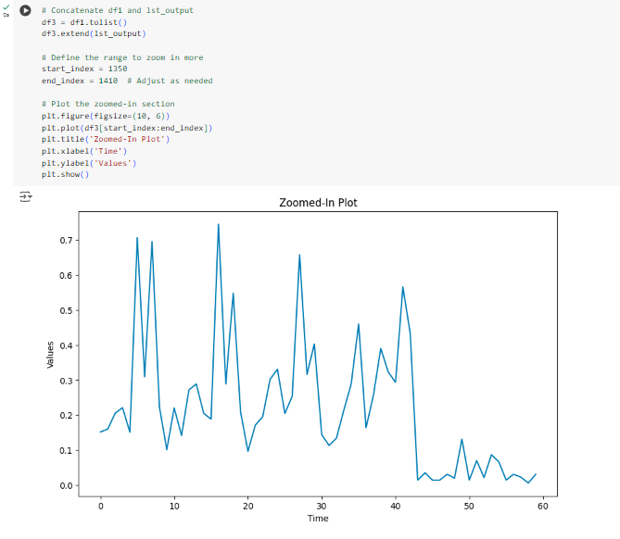
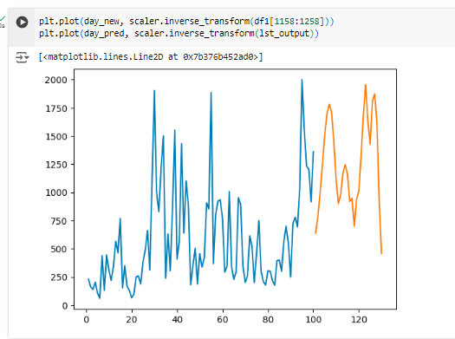
This finally demonstrates the addition od the 30 day prediction to the prediction curve

Slide 30
Finale

Slide 31


Things I Learned
Impact of Window Size
Handling Missing Values
The window size significantly affects the model's ability to capture long-term dependencies. Balancing complexity and generalization is key to preventing overfitting.
Data Visualization
Properly addressing missing values and transforming categorical variables into numerical formats is essential for accurate model training.
Effective data visualization is crucial for understanding trends and seasonality. Analyzing smaller sections of the data can reveal important insights.

Slide 32
Conclusion

Slide 33
Thanks!
Do you have any questions?
suzyadel37@gmail.com
+201204407191
https://www.mentorness.com/

